Slide 1
NYS Common Core Social Studies Framework Presentation Adapted by Dr. Elizabeth Frangella Diocese of Brooklyn Pat Trimper Diocese of Buffalo
Original presentation by: Greg Ahlquist
Notes:
Purpose is the integrated study of the social sciences and humanities intended to promote civic competence.
Social studies provides coordinated, systematic study drawing upon such disciplines as: anthropology, archeology, economics, geography, history, law, philosophy, political science, psychology, religion, belief systems, and sociology.
Also contains important info from humanities, math, and natural sciences.

Slide 2
Session objectives
To help educators gain a deeper understanding of the NYS Social Studies Framework, the Social Studies practices and skills, and the NYS Field Guide.
To discuss how the framework should change teaching and learning by working through a sample inquiry.
To navigate the toolkit and use the inquiry design blueprint.

Slide 3
Our Work in Social Studies
Framework
(content and skills)
Curriculum
(inquiry, Toolkit Project and resources)
Assessment
(Regents and local)
Notes:
All of these pieces work together and are aligned.
Our work as districts and teachers, in the coming years, is to build CURRICULUM and have it aligned to ASSESSSMENT and the FRAMEWORK
METAPHOR of images: Blueprints are like the Framework (set the course), Curriculum (Toolkit and work being done now), and Quality Control (is assessments being designed now)
BUILDING METAPHOR
Our goal is to build the capacity in our teachers and to prepare students for 2018 when the new Global Regents exam is given.

Slide 4
Making the Most of our Time…
With a partner, answer the following questions:
What do you already know about the NYS SS Framework?
What are you most concerned about with the implementation of the Framework?
What do you hope to get out of today’s session?

Slide 5
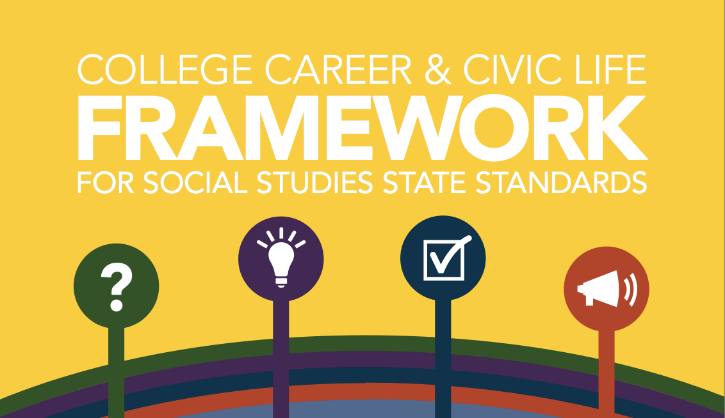
Notes:
This work begin shortly after the adoption of the Common Core Learning Standards by New York State in 2010. There had been consideration of just taking the existing Core Curriculum and Resource Guide and develop lessons that demonstrate how common core practices could be used in social studies. However, a decision was made to be sure to clearly articulate the social studies skills and practices. The social studies disciplines require different skills beyond reading, writing, speaking and listening.
One challenge to this work was to incorporate the important events since the last published guide, which did not include 9/11 or the election of President Obama. However, the incorporation of additional material necessitated a critical look at what could be deleted, as the intent was also to offer students an opportunity to delve deeper into content.

Slide 6
C3 Inquiry Arc
Inquiry Arc
Dimension 1: Developing Questions and Planning Inquiries
Dimension 2: Applying Disciplinary Tools and Concepts (Civics, Economics, Geography, and History)
Dimension 3: Evaluating Sources and Using Evidence
Dimension 4: Communicating Conclusions and Taking Informed Action
What is the C3 Framework?
Notes:
When you look at the dimensions, the most important ones are dimensions 1 and 4.
Looking at dimension one, the shift is not only having teachers develop questions but having students develop them and moving from the textbook to writing inquiries. We will show an example of an inquiry in a little while.
Dimensions 2 and 3 are using those tools that teachers already know how to use and expanding the use of sources and using evidence to back up claims, somewhat like the ELA shifts.
You remember that there were 6 shifts in ELA
- Fiction to nonfiction, staircase of complexity, writing from sources, knowledge in the disciplines, text-based answers, and academic vocabulary
Dimension 4 can be the most controversial of the dimensions. You are asking students to make conclusions from what they have learned and then to take informed actions. We would want those informed actions to be under the umbrella of our value systems.
Later, we will show you how we did that in our dioceses.

Slide 7
IDM follows C3 Inquiry Arc
Students answer in the form of a SUMMATIVE
ARGUMENT
If students are asked a COMPELLING question……
In the middle are the SUPPORTING
QUESTIONS, FORMATIVE TASKS,
AND SOURCES
Notes:
This slide highlights the basis for compelling questions in Dimension 1 of the C3 Framework.
In content-rich subjects, like social studies, teaching and learning have traditionally focused on facts first and thinking later. That approach has not worked for all students. The C3 Inquiry Arc reframes that traditional approach by highlighting the use of compelling questions as a way to drive a social studies inquiry.

Slide 8
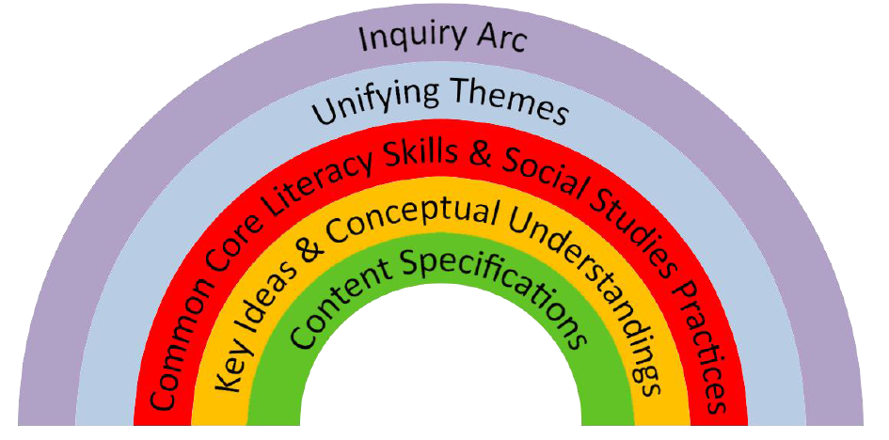
Inquiry Arc
Why?
What?
How?
Notes:
Looking at the what, we are talking about the content and those conceptual understandings. That hasn’t changed.
When we look at the how, that is where the Social Studies practices and the literacy skills come in.
While the practices were always in the Social Studies standards, I am not sure that teachers really paid attention to them.
The big change is in the why. That is in the inquiry arc and the unifying themes; there is a template involved. You will see the template soon.
The shift has teachers writing units of study similar to the units of study we ask for in ELA but we give teachers a lot more freedom in this model to choose resources and content.

Slide 9
Same 5 NYS Social Studies Learning Standards
Standard 1: History of the United States and New York
Standard 2: World History
Standard 3: Geography
Standard 4: Economics
Standard 5: Civics, Citizenship, and Government
Notes:
As we said before, the Standards have not changed; it is the delivery that has to change.

Slide 10
Course of Study Remains Same
Grade | Course of Study
Kindergarten | Self and Others
Grade 1 | My Family and Other Families, Now and Long Ago
Grade 2 | My Community and Other Communities
Grade 3 | Communities around the World
Grade 4 | Local History and Local Government
Grade 5 | The Western Hemisphere
Grade 6 | The Eastern Hemisphere
Grade 7 | United States and New York History – I
Grade 8 | United States and New York History – II
Grade 9 | Global History and Geography – I
Grade 10 | Global History and Geography – II
Grade 11 | United States History and Government
Grade 12 | Participation in Government Economics and Economic Decision Making
Notes:
With the exception of Grade 5, all course of study remains the same.

Slide 11
NY Social Studies Framework 3 Instructional Shifts
Focus on Conceptual Understanding.
Foster Student Inquiry, Collaboration, and Informed Action.
Integrate Content and Skills Purposefully.
Notes:
Take a minute to read through the Social Studies instructional shifts; we will work through each one next.

Slide 12
Instructional Shift #1: Focus on Conceptual Understanding
From
To
Facts
????
Concepts and Content Knowledge
Breadth of Topics
Depth within Topics
????
Recall
????
Transfer and Connections
Notes:
Please take a minute and jot down on a piece of paper what you think we are moving to.
The shift is to take history and bring it into the current day and ask what have we learned and how can we take what we learned about the past and apply it to the current day.
To do that, teachers need to know where to go for resources, including multimedia, to help with their teaching. We will share some of this at the end.

Slide 13
Instructional Shift #2: Foster Student Inquiry, Collaboration, and Informed Action
From
To
Teacher as Disseminator
????
Teacher as Facilitator of Investigation
Students Learn Facts from Textbook
????
Students Investigate the Social Sciences Using Multiple Sources
Students Retell Interpretations
????
Students Construct Interpretations and Communicate Conclusions
Notes:
What predictions can you make for what we are asking teachers to move to in shift 2?
This one can be somewhat controversial as we are looking for students to construct interpretations and communicate their conclusions.
This is where the students plan their informed actions; how can they make a change in their world.
Informed action can go all the way down to kindergarten. The students had pancakes but no syrup and they were upset. The teacher asked them what they wanted to do about that; students decided to talk to the cafeteria workers. They learned that there was no money for syrup. While they did not get syrup, they did take action instead of staying upset about not having syrup.

Slide 14
Instructional Shift #3: Integrate Content and Skills Purposefully
FROM A Social Studies Classroom Where… | TO A Social Studies Classroom Where…
Students experience an additional nonfiction reading class or textbook focused instruction | Students learn to read, discuss, and write like social scientists
Students develop literacy skills and social studies practices separately | Students develop disciplinary literacy skills and social science practices in tandem
Students learn content knowledge | Students integrate and apply concepts, skills, and content knowledge
Notes:
This is the last time we will ask you to predict – what do you think will be under the “To” column”?
This reminds us of the ELA shifts where we have students read like a detective and write like an investigative reporter. In Social Studies, we have them think like a geographer, political scientist , historian or an economist, read like social scientist, and write like an archeologist.

Slide 15
From the Field Memo
March 3, 2015 Candace Shyer
“The content, skills, and social studies practices in the New York State K-12 Social Studies Framework must be built across grades K-12 for students to be successful on the social studies assessments required for a diploma.
Instruction in ELA modules that incorporate social studies topics does not replace instruction in social studies, particularly in the development of social studies practices.
All teachers of social studies in all grades should review the social studies practices, as well as the common core literacy skills for their courses, and incorporate them, along with content, into their instruction.”
Notes:
By a show of hands, how many people are having their teachers use the ELA modules?
When the ELA modules came out, a lot of people bought into the idea that since Social Studies is embedded into the modules, that teachers did not have to teach Social Studies any more. NYSED’s Social Studies people came out and said that ELA modules did their own thing; now it is time for the Social Studies people to speak out. ELA has not absorbed Social Studies.
Please remember that Social Studies is not replaced in the classroom by using the ELA modules.

Slide 16
What do the shifts mean for instruction?
For each shift discuss:
What do I notice that is already in place?
What is new?
What are some next steps that can be taken?
What are some barriers?
Reminder of Shifts:
Focus on Conceptual Understandings
Foster Student Inquiry, Collaboration, and Informed Action.
Integrate Content and Skills Purposefully.
1
Notes:
Please take the first handout – this is work that you can do in your own building with your faculty. This will help you see the direction that your teachers need to go with Social Studies.

Slide 17
Notes:
Go to engageny.org, enter Social Studies in the search bar, scroll down and look for the framework and field guide.

Slide 18
5 Points of Clarification: Commissioner’s Regulations changes, Social Studies Regents Exams, and Pathways
Pathways & Assessment Changes
1. Commissioner’s Regulations will require Social Studies sequence of study for Grade 9, Grade 10, Grade 11, Grade 12
-Grade 9 Global was not required and this change ensures this course of study
2. New Global Regents Exam will assess ONLY 10th grade course (starting June 2018)
3. New US History and Government Regents Exam (starting June 2019)
4. In ALL pathways, all Students earning a Regents Diploma will:
• Take a Balanced Curriculum including: American History, Global Studies, Science, LOTE, Art, Physical Education and Health
Notes:
For High School ( and eighth grade teachers too)
The Board of Regents asked that the Global History and Geography course be split into two distinct courses. This necessitated looking carefully at how the course was currently taught, asking the field for recommendations on how to split the course and finally making a decision with a chronological course of study that is focusing on the “modern era” (post 1750) for grade 10.

Slide 19
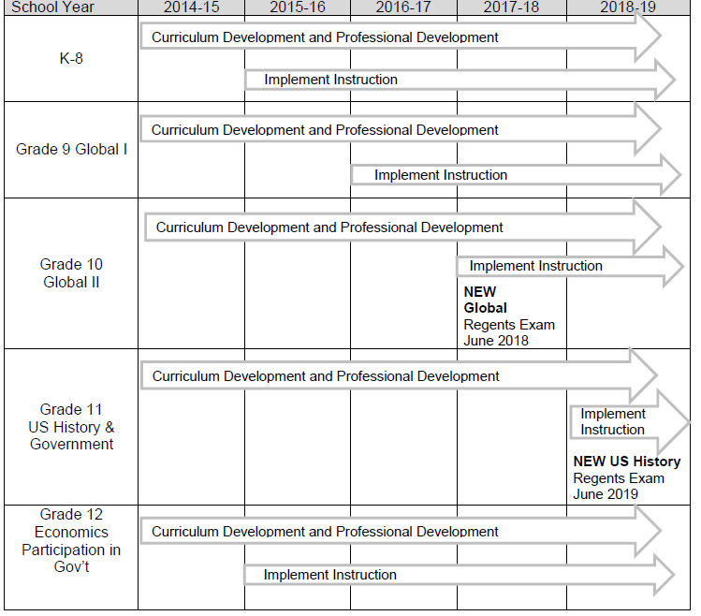
Notes:
This is a view of NYSED’s timeline for

Slide 20
Social Studies Practices *
1. Gathering, Using, and Interpreting Evidence
2. Chronological Reasoning and Causation
3. Comparison and Contextualization
4. Geographic Reasoning
5. Economics and Economics Systems
6. Civic Participation
* What skill/practice do I see when I observe a Social Studies lesson?
Notes:
Here is a list of the 6 Social Studies Practices.
Note that the first Practice is an “umbrella” practice in that it utilizes all 4 “sub-disciplines” of social studies: History, Geography, Economics, Civics.
As you observe classes, watch for the Social Studies skills and/or practices.

Slide 21
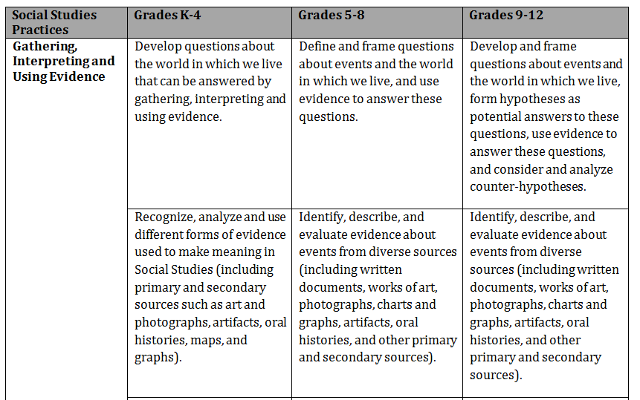
Vertical Articulation of Social Studies Practices
Notes:
Look at the vertical articulation through the lens of Bloom’s taxonomy (attention to verbs) or Webb’s Depth of Knowledge (rigor involved).

Slide 22
Literacy through social studies
Connections between the C3 Framework and the CCR Anchor Standards
Dimensionshttps://www.engageny.org/resource/grade-7-social-studies-making-sense-common-sense-elarss7-81 | ELA Connections
D1: Developing Questions and Planning Inquiries | R1 W7 SL1
D2: Applying Disciplinary Concepts and Tools | R1-10 W7 SL1 L6
D3: Evaluating Sources and Using Evidence | R1-10 W1, 2, 7-10 SL1
D4: Communicating Conclusions and Taking Action | R1 W1-8 SL1-6
2
Notes:
SS Video
Each of the dimensions relates to the ELA reading, writing and speaking and listening standards. Dimension 2 also speaks to the Language standards.
In this Common Core Social Studies video of 7th grade students from Willink Middle School in Webster, NY students do a close read of excerpts from the challenging primary text, Common Sense. This lesson focuses on Social Studies Standard 1: History of the United States and New York. Students will use a variety of intellectual skills to demonstrate their understanding of major ideas, eras, themes, developments, and turning points in the history of the United States and New York and Key Idea #1 Intermediate: Students will interpret the ideas, values, and beliefs contained in the Declaration of Independence and the New York State Constitution and United States Constitution, Bill of Rights, and other important historical documents. Mr. Powers gives students time to read and debate Thomas Paine's writing and determine the meaning and purpose of this primary source.
3 clips: 0:23 – 2:30; 3:37 – 4:31, 7:05 – 7:20

Slide 23
How to Read the Framework
4.5 IN SEARCH OF FREEDOM AND A CALL FOR CHANGE: Different groups of people did not have equal rights and freedoms. People worked to bring about change. The struggle for rights and freedoms was one factor in the division of the United States that resulted in the Civil War.
(Standards: 1, 5; Themes: ID, TCC, SOC, CIV)
4.5a There were slaves in New York State. People worked to fight against slavery and for change.
Students will examine life as a slave in New York State.
Students will investigate people who took action to abolish slavery, including Samuel Cornish, Fredrick Douglass, William Lloyd Garrison, and Harriet Tubman.
Key
Idea
Conceptual
Understanding
Content Specifications
Notes:
This is what the framework looks like.
The framework has key ideas (In search of freedom and a call for change), conceptual understandings (There were slaves in NYS), and content specifications – what the student is expected to know and be able to do.

Slide 24
4.5 IN SEARCH OF FREEDOM AND A CALL FOR CHANGE: Different groups of people did not have equal rights and freedoms. People worked to bring about change. The struggle for rights and freedoms was one factor in the division of the United States that resulted in the Civil War. (Standards: 1, 5; Themes: ID, TCC, SOC, CIV)
4.5a There were slaves in New York State. People worked to fight against slavery and for change.
Students will examine life as a slave in New York State.
Students will investigate people who took action to abolish slavery, including Samuel Cornish, Fredrick Douglass, William Lloyd Garrison, and Harriet Tubman.
Catholic Connection: Solidarity
We are one human family. We are brothers and sisters even if we are different. We need to get along with each other. Solidarity means not fighting but helping others. We should love our neighbors all over the world.
By the completion of Grade Four, the learner will: realize that the Lord calls each of us to live a life of service.
Notes:
When the ICC was doing the Framework project for our superintendents, we added a Catholic connection from the seven Social Justice teachings. (Life and Dignity of the Human Person, Call to Family, Community and Participation, Rights and Responsibilities, Option for the Poor and Vulnerable, The Dignity of Work and the Rights of Workers, Solidarity, and lastly, Care for God’s Creation). We would like to suggest that doing a project like this to connect the Social Studies Framework to your faith is an excellent way to insure that there is no bias against any religion and to give teachers ownership of the framework.

Slide 25
Notes:
Creates inquiries that utilize a design structure that teachers can mold to fit their teaching
-Works on the premise that the teacher is the guide who makes important design decisions (based on students, content, curriculum, and countless variables unique to local context)
-Marries global vision of C3 Framework with the grade level guidance (content, skills, etc.) of NYS SS Framework

Slide 26
Notes:
Here is a grade 4 inquiry written around geography. The compelling question being considered is “Does where you live matter?”
** Walk people through each section.

Slide 27
Compelling questions
1. Intellectually meaty
Reflects an enduring issue, concern, or debate in the field
Demands the use of multiple disciplinary lenses and perspectives
2. Kid friendly
Reflects a quality or condition that we know children care about
Honors and respects children’s intellectual efforts
Notes:
Characteristics of compelling questions:
Set the opening frame for an inquiry
Express the intellectual rigor and student relevance of an inquiry
Set up the summative performance task
A compelling question:
Reflects an enduring issue, concern, or debate in the field
Demands the use of multiple disciplinary lenses and perspectives
A compelling question:
Reflects one or more qualities or conditions that we know children care about
Honors and respects children’s intellectual efforts

Slide 28
Compelling…or not so compelling?
Where are we?
What were the causes of the Industrial Revolution?
Why is Albany the capital of New York?
Can Canada and the US be friends forever?
Who won the Cold War?
Who are our community helpers?
What’s the deal with hair?
Notes:
Intellectually Meaty: Does this question require students to use broad conceptual frameworks to interpret knowledge and information? Does it require students to pay attention to specific social studies content?
Student-Friendly:
Is this question intriguing to students? Will answering this question allow students to interrogate evidence and build an argument?

Slide 29
Supporting questions
Support and extend the Compelling Question
Represent the disciplinary knowledge desired
Reflect the sources selected
Inspire formative assessments
Notes:
As you saw in the grade 4 geography inquiry, the compelling question is followed by supporting questions. These are some guidelines for supporting questions.

Slide 30
Formative Performance Tasks
Connect sources to Supporting Questions
Help students build their emergent understandings
Contribute to students’ abilities to respond to the Summative Performance Task.
Notes:
The purpose of assessment is for learning. Embedded formative assessment tasks are activities designed to help students practice the skills and acquire the content needed to perform well on the summative task (the argument). They are built around the supporting questions and are intended to grow in sophistication across the tasks. The performance tasks threaded throughout the inquiry provide teacher multiple opportunities to evaluate what students know and are able to do so that teachers have a steady loop of data to inform their instructional decision making.

Slide 31
Summative Performance Task: Argument
An argument: a collection of claims supported by relevant evidence, which can be considered an answer to the question investigated by the research
ARGUMENT STEMS- are also considered THESIS STATEMENTS. They are CONTENT MARKERS. If something is NOT in your argument stem, you have made a wrong turn.
Notes:
Each inquiry ends with the students constructing an argument (detailed outline, drawing, essay) that addresses the compelling question using specific claims and relevant evidence from sources while acknowledging competing views.
In the framework, there are argument stems and you can find them in the C3 Teachers site.

Slide 32
3, 4
Notes:
This is what an inquiry looks like. You have 2 handouts – a blank Inquiry Design Model and a template with descriptions.
Take a few minutes and look over the inquiry and share your ideas with your neighbor.

Slide 33
IDM: Taking Informed Action
Community |  |  | Organize a boycott or fundraising event
School |  |  | Circulate a petition School newspaper special issue Organize an assembly
Classroom | Research an issue relevant to an Inquiry | Identify the problem and possible civic solutions or actions | Bringing stakeholders together for a forum Write a letter to the editor
 | Understand the problem | Assess | Apply an Action
Notes:
These can also relate to your own values that you and your faculty teach and model at your school.

Slide 34
Resources to Explore
www.C3teachers.org
https://www.engageny.org/resource/new-york-state-k-12-social-studies-resource-toolkit-kindergarten-grade-4
www.NOVELNEWYORK.org
www.loc.gov
5

Slide 35
Resources
www.C3teachers.org
https://www.engageny.org/resource/background-new-york-state-k-12-social-studies-framework
https://www.engageny.org/resource/new-york-state-k-12-social-studies-field-guide
https://www.engageny.org/resource/new-york-state-k-12-social-studies-resource-toolkit-kindergarten-grade-4
https://www.engageny.org/resource/new-york-state-k-12-social-studies-resource-toolkit-grades-5-8
www.NOVELNEWYORK.org
www.gutenberg.org

